Slide 1


Evolving Education: Challenges and Solutions
CONSULTATION ON THE INITIATIVE ON THE EVOLVING RIGHT TO EDUCATION
I.C. FRATTAMAGGIORE 3 - G. GENOINO - CLASSE 3 I
HEAD TEACHER: ANGELA CECERE
TEACHERS: MARIA MASCOLO - GUIDO RUSSO - MARIAROSARIA QUARANTA

Slide 2
Brainstorming
“One child, one teacher, one pen and one book can change the world.”
- a decrease in ignorance and illiteracy
-an increase in independence
-a better education can lead to higher incomes and a greater possibility of purchasing a house
-education fosters critical thinking to create informed citizens
- school is the first environment in which people learn to socialise
- education raises awareness on global issues
- equips people to react to situations or make decisions
- fosters a mindful approach to technology
- with a good education it is easier to aim at more lucrative jobs
- helps overcome social and cultural barriers
- thanks to specialised study programmes, society can rely on qualified experts such as doctors and psychologists
- enables the development of one’s passions
- helps to understand the rules of society
- teaches empathy
- gives a voice to those who have none

Slide 3
Why is education a right?
Empathy and rules: school as life's first training ground.
Farewell to ignorance: critical thinking for free citizens
Global awareness to face the world's challenges
Less unemployment, more independence: the right to housing and to the future.
Digital citizenship: using technology with awareness
Autonomy and passions: learning to decide and act
Beyond all borders: overcoming social barriers and giving a voice to the voiceless
Talent and research at the service of everyone:doctors, psychologists, and specialists.

Slide 4
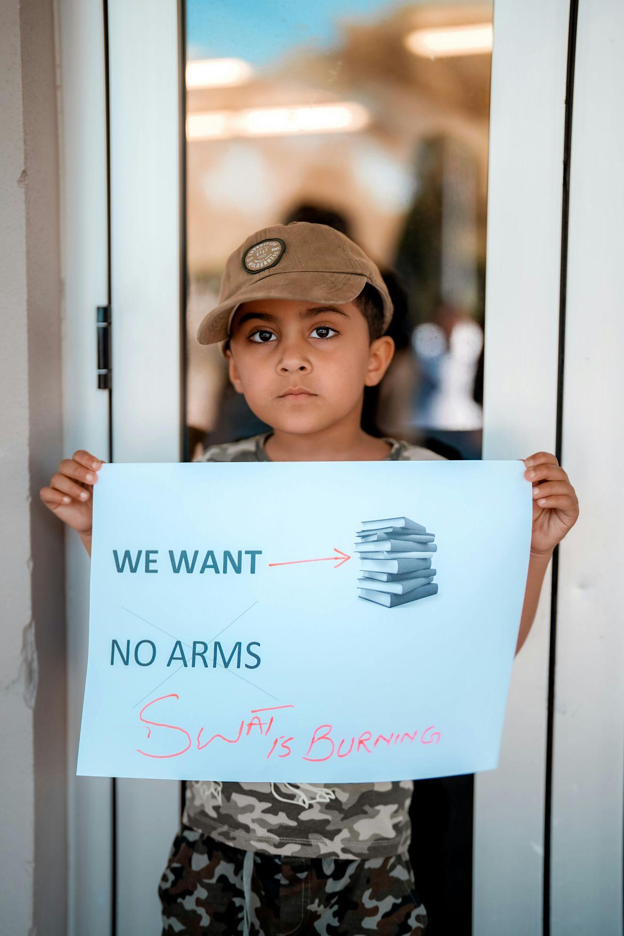
INTRODUCTION
We think that education is fundamental for our personal development: it fosters critical thinking, leading us to reason and develop solutions, thus making us more independent and aware of our choices. School is not just a place in which we only study , it is the first social environment in our lives; school allows us to develop and concretely realize our passions.
Regarding social and economic well-being, education has led to a reduction in illiteracy and unemployment. Thanks to the digitalization, and provision of tools (such as PCs, tablets, or interactive whiteboards), schools offer the same opportunities to children with learning, sensory, and motor difficulties.
Education is crucial to create a good future citizen, with the right skills to lead society forward, overcoming social and cultural barriers.

Slide 5
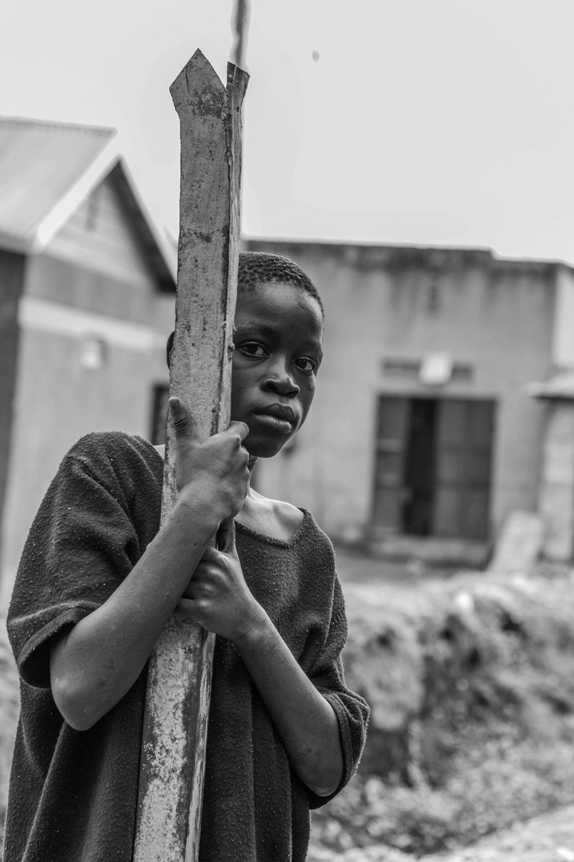
TOPIC 1 - VULNERABLE GROUPS
According to data released by UN WOMEN, the United Nations agency for gender equality and women's empowerment, 1 in 10 women worldwide lives in extreme poverty. Over 300 million working women live in poverty with no opportunity to become rich.
Despite being more determined than men, their participation in education is only 30%.
According to the World Bank, if women had the same opportunities as men, they would provide support in the workplace, boosting the country's economy and giving more hope for our future.
How to solve the problem
In our opinion, to live in a better world, every country should provide financial support to poor families in order to send girls to school, thus eliminating forced marriage, early labor, and child labor.

Slide 6
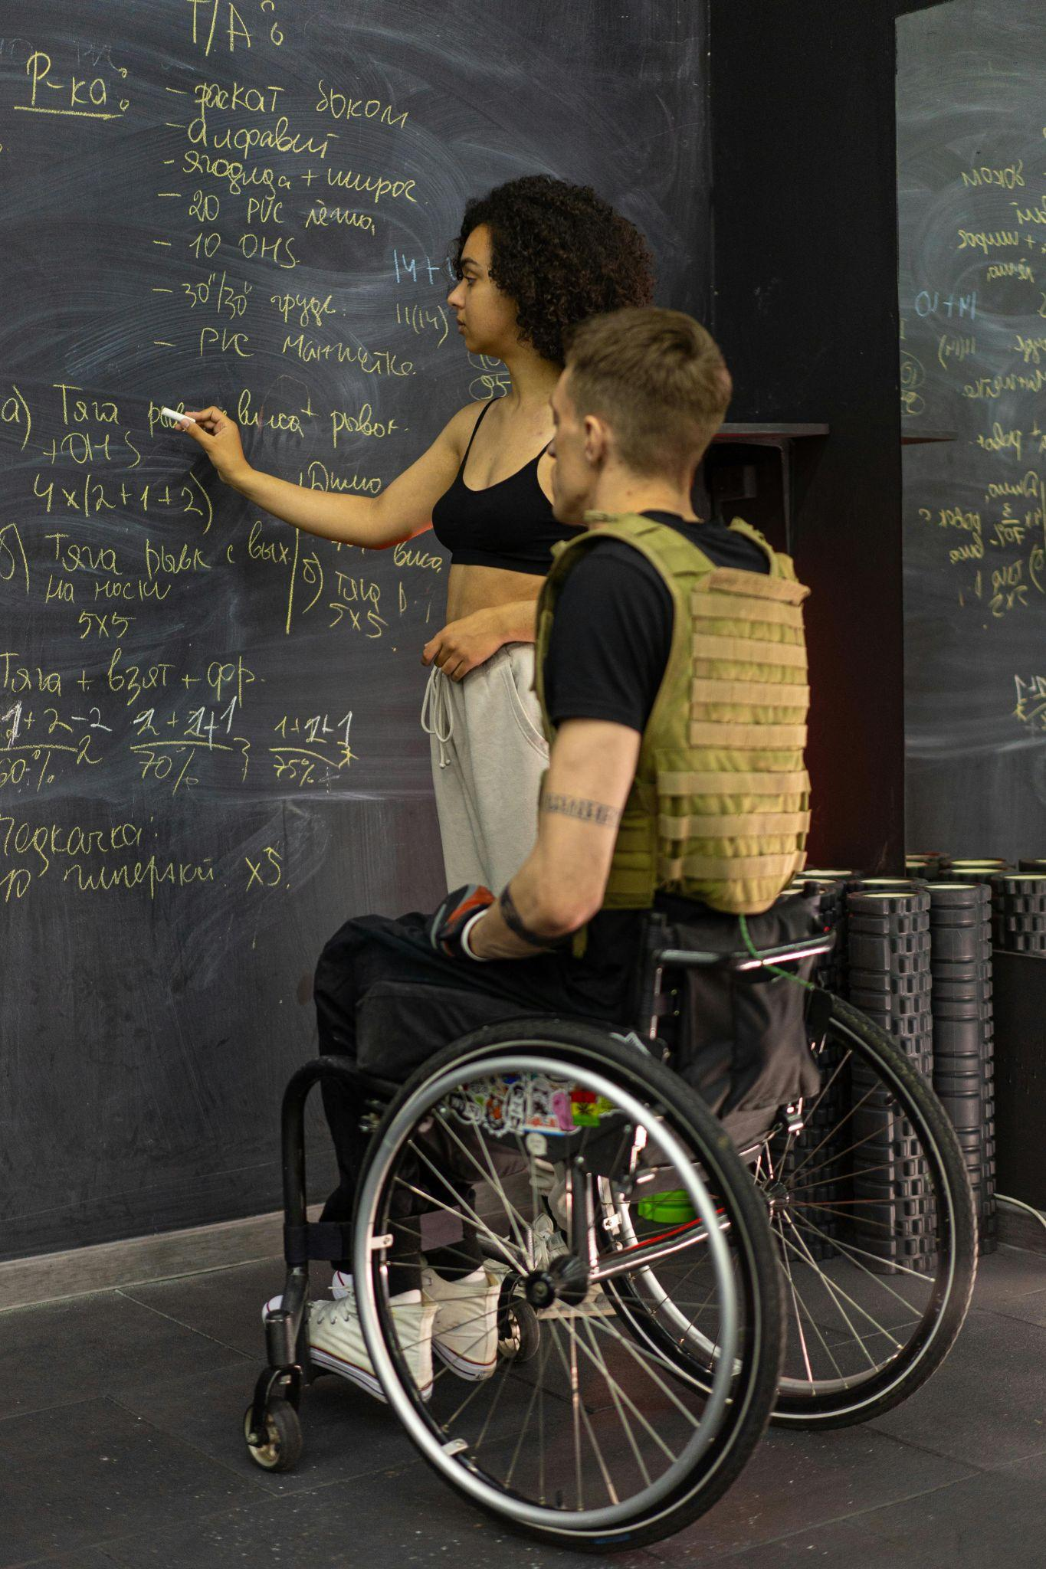
…
There are currently approximately 240 million children with disabilities in the world. The problem is that, especially in poorer countries, approximately 50% of them never set foot in a classroom. In some areas, this figure is as high as 90%. UNESCO data tells us that in some countries, teachers are unable to manage these children; in 67% of schools, ramps and elevators are missing. All of this can have enormous consequences, creating a "forced brain drain," where minds that could solve global problems remain untapped and the world loses its most empathetic and inclusive generations, while also risking an increase in bullying.
How to solve the problem
We must remove physical barriers, build accessible schools with safe transportation to get there, use technology such as screen-reading software for the blind, or create special keyboards to simplify texts and translate everything instantly.

Slide 7
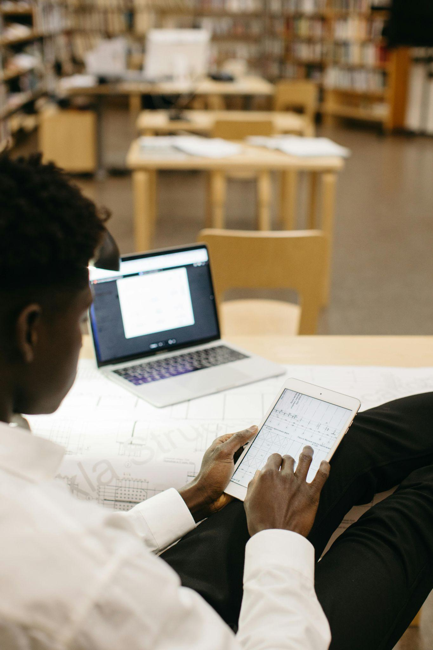
TOPIC 2 - THE DIGITALIZATION
We are used to thinking of digitalization as an unstoppable process, but UNESCO data tells us that over 2.2 billion people have never accessed the internet. Furthermore, only one in ten children with disabilities in low- and middle-income countries has access to the necessary assistive technologies. Although dyslexia affects 10% of the world’s school-age population, fewer than 15% of schools provide support software. In many regions, the cost of such software exceeds three months’ average salary, turning the right to education into an economic and geographical luxury. Today, the inability to access software creates a new form of marginalisation, similar to that described by Daniel Pennac in his *School Diary * Here, the author recounts the ‘pain of the dunce’, the plight of those who fall behind not for lack of intelligence, but for lack of support.
But digital exclusion is not just about a lack of tools; it is also about who designs those tools…

Slide 8
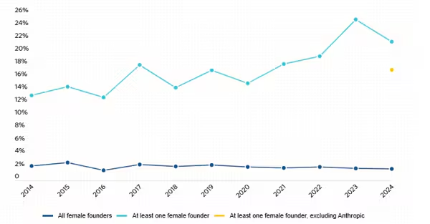
Women, just like students with disabilities, are marginalised in the digital world: accessing technological creation (app and software development) presents obstacles that are difficult to overcome for women. Although women account for over 55% of university graduates, only 20% choose to study STEM disciplines. In fact, cultural prejudices persist that portray technology as a field for ‘men only’, thereby discouraging girls from their earliest school years. Furthermore, the lack of female role models in textbooks and the media prevents female students from identifying with these roles, making careers in technology seem distant and hard to imagine.
Furthermore, developing technology requires funding. Venture capital data shows that less than 3% of global funding goes to start-ups founded exclusively by women. This barrier prevents women from turning their ideas into real products, leaving software development almost exclusively to men
“If we look at early-stage start-ups, the percentage is even lower: in 2024, only 20.5% of the 3,121 funding rounds involved at least one female co-founder, compared with 26.5% four years ago.”
From:
Il Sole 24 Ore online, 22 January 2025

Slide 9
FIRST PROBLEM: The digital divide
When we consider that, globally, only one in ten children with disabilities has access to the necessary assistive technologies, we are not merely looking at a statistic reflecting a material shortage; every time a brilliant mind is silenced due to the lack of digital support, society as a whole suffers an incalculable loss: we lose the apps that will never be written, the discoveries that will never be made – in short, we lose minds that could revolutionise the world
How to solve the problem
In our view, every student with a disability or SLD should receive a digital kit – specifically, a tablet equipped with assistive software and speech synthesis – and, above all, this should be free and open-source, as many families would be unable to afford such costs

Slide 10
SECOND ISSUE: Gender digital divide
Firstly, one of the consequences of the gender digital divide is that, since AI learns from the data we provide, a tech world without women produces algorithms that amplify sexism: if, for example, we ask artificial intelligence to generate an image of an architect, it will almost certainly produce an image of a male architect, even though female architects also exist. Furthermore, the development of apps, software and digital products by teams consisting solely of men or with a male majority adequately meets the needs of less than half the world’s population.
How to solve the problem
In our view, to limit gender inequality in the IT sector, it is necessary to ensure that every working team is made up of 50% men and 50% women. Furthermore, governments should create tax incentives and guaranteed funds to support female-led tech start-ups. Given that currently only 3% of funding goes to women (Source: Crunchbase), one solution could be to create funding channels that reward gender diversity in development teams.

Slide 11
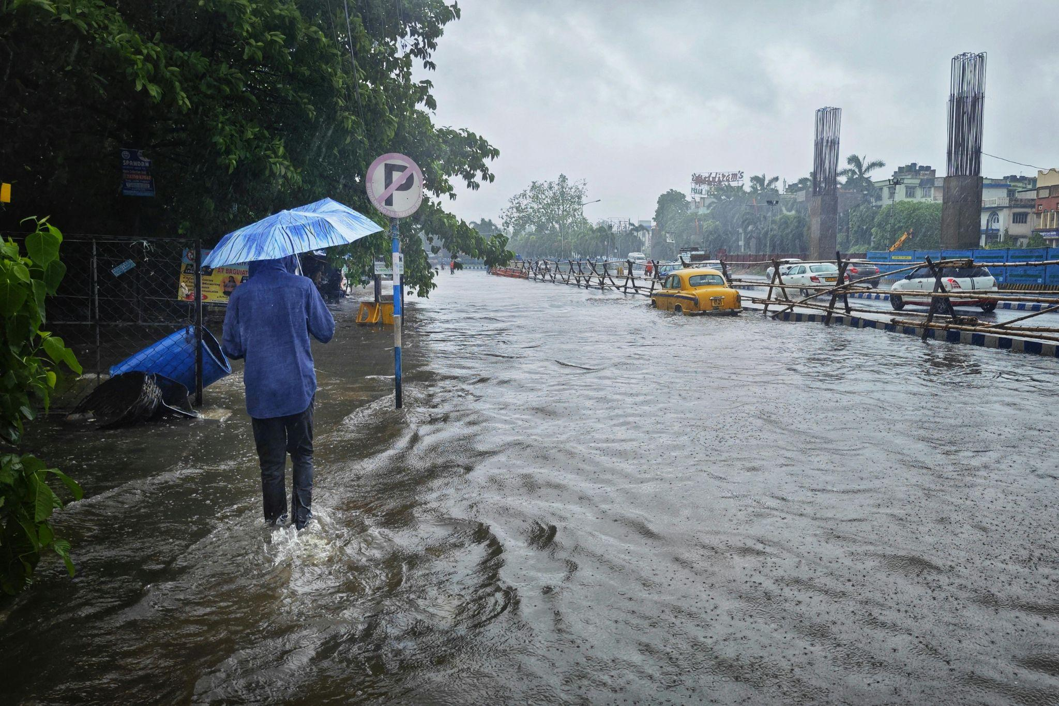
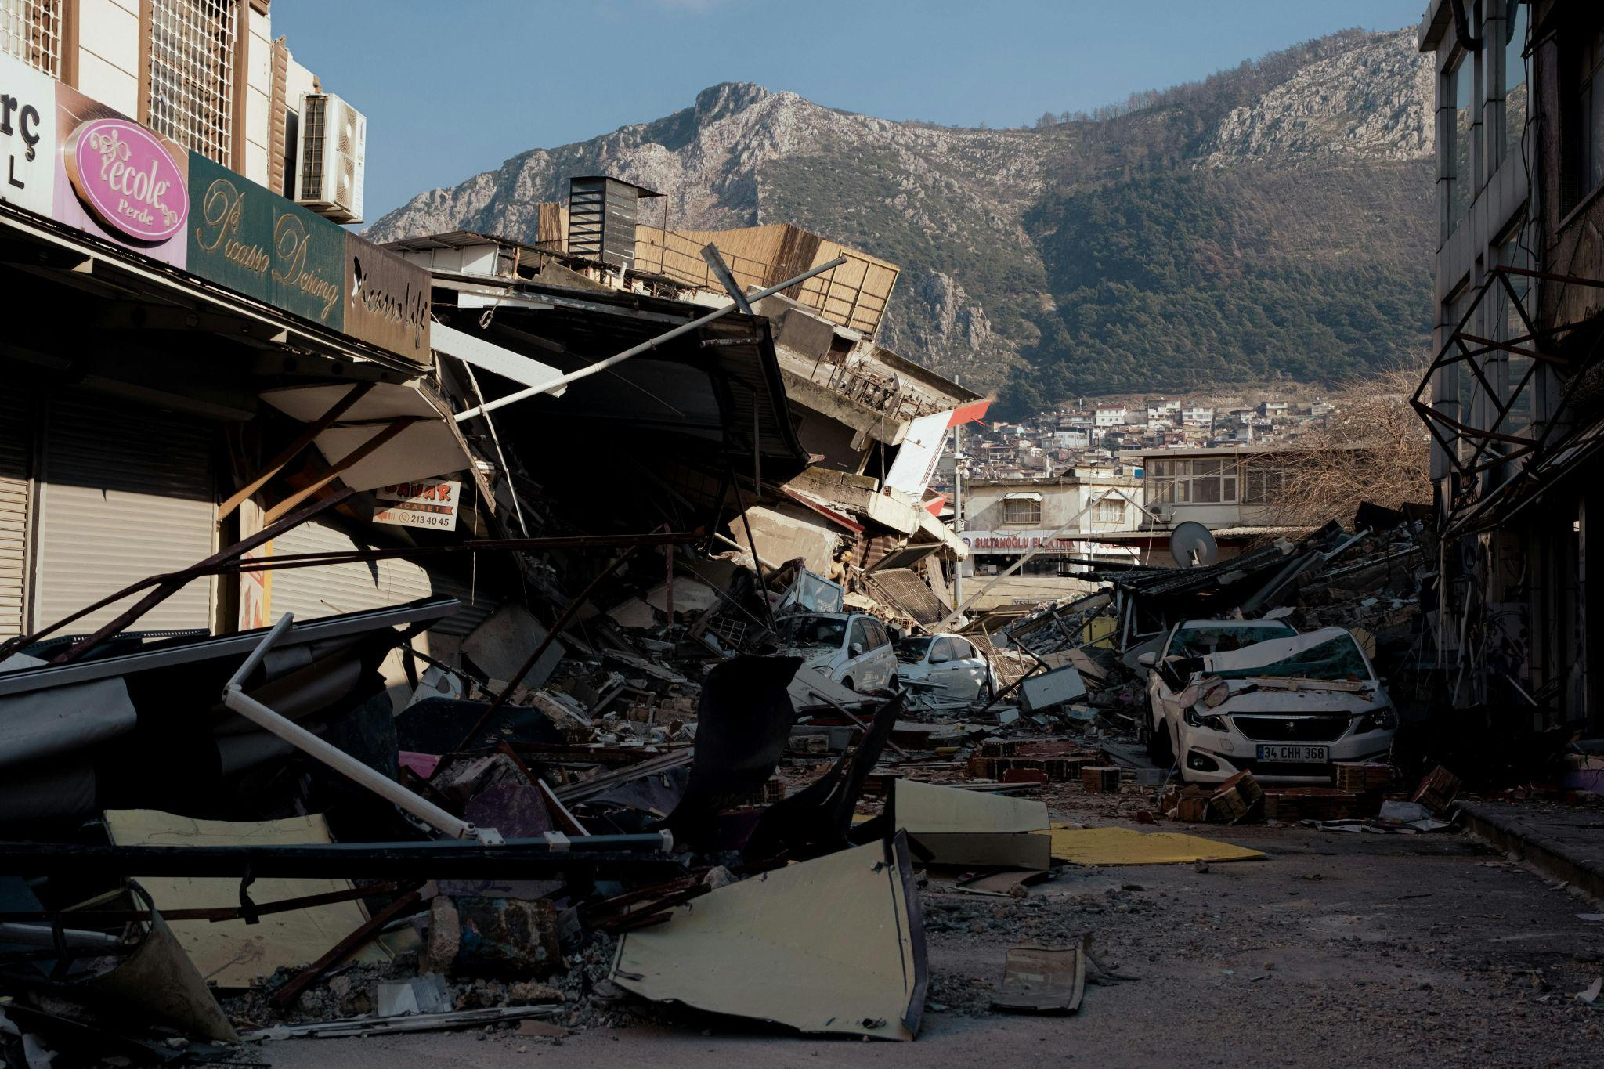
Climate change is literally stealing time from learning, especially in poor countries.
A recent UNESCO report indicates that by 2030, global warming could reach plus 1.5°C. Other data shows that in 2018, 17.2 million people were forced to leave their homes due to natural disasters, such as floods or earthquakes. By 2020, this number had risen to 30.7 million due to extreme weather events…
TOPIC 3 - CLIMATE CHANGE

Slide 12
…
The main problems that prevent many young people from accessing education are:
Heat waves: Many schools, especially older ones, are not equipped with air conditioning. When temperatures exceed 35/40 degrees, the school environment becomes harmful to health.
Floods and cloudburst : Increased rainfall over very short periods can flood streets, making transportation impossible, or even submerge the ground floors of schools.
Storms and strong winds: Intensifying hurricanes or storms can cause structural damage or the fall of trees and power lines near schools.
HOW TO SOLVE THESE PROBLEMS:
Resilient infrastructure: We must build schools that can withstand floods and hurricanes.Resilience doesn't mean an indiscriminate increase in structural performance. Rather, it relies on a thoughtful analysis of climate risks and their integration into the design concept.
Thermal efficiency: We must Install passive ventilation systems and white or green roofs to reduce internal temperatures without excessive air conditioning.
Schools as emergency hubs:We must design schools to serve as safe havens for the community during climate-related disasters.

Slide 13
Credits
COVER
Photo by Gustavo Fring: https://www.pexels.com/it-it/foto/scale-ragazza-seduto-bambini-5621884/
Photo by Sora Shimazaki: https://www.pexels.com/it-it/foto/foto-di-cartelli-e-vernice-spary-5926357/
INTRODUCTION
Photo by Mushtaq Hussain: https://www.pexels.com/it-it/foto/banner-faccia-bambino-tenendo-14139195/
VULNERABLE GROUPS
Photo by Kalz Michael: https://www.pexels.com/it-it/foto/uomo-etnico-nel-villaggio-contro-vecchie-capanne-4384289/
Photo by Mikhail Nilov: https://www.pexels.com/it-it/foto/uomo-in-canotta-marrone-che-si-siede-sulla-sedia-a-rotelle-7698276/
DIGITALIZATION
Photo by Yaroslav Shuraev: https://www.pexels.com/it-it/foto/lavorando-seduto-tavoletta-digitale-progetto-6279781/
https://www.ilsole24ore.com/art/in-calo-investimenti-venture-capital-start-up-fondate-donne-AGtff5RC?refresh_ce
CLIMATE CHANGE
Photo by Doruk Aksel Anıl: https://www.pexels.com/it-it/foto/strada-rotto-spazzatura-turchia-15823390/
Photo by Dibakar Roy: https://www.pexels.com/it-it/foto/citta-auto-persona-acqua-26202094/

Slide 14
THANK YOU FOR YOUR ATTENTION
HEAD TEACHER : Dott ssa. Angela Cecere
Teachers : Maria Mascolo, Mariarosaria Quaranta, Guido Russo
Class III I :
TOPIC 1 - VULNERABLE GROUPS:
Arianiello Adelaide, De angelis Maria, Russo Annachiara, Esposito Gioia Benedetta, Pellino Carmela, Piccolo Vincenzo, Perrotta Christian
TOPIC 2 - DIGITALIZATION:
Esposito Ferdinando, Marino Melissa, Mormile Mariarosaria, D’angelo Domenico, Del Prete Giovanni, Agorini Antonia
TOPIC 3 - CLIMATE CHANGE : Orefice Mayra, Vittorioso Vincenzo, Centore Gennaro, Del Prete Sara, Grimaldi Martina, Castaldo Irene Rita, Perotta Carmela

